Slide 1

SweepCache:
Intermittence-Aware Cache on the Cheap
Yuchen Zhou¹, Jianping Zeng¹, Jungi Jeong²,
Jongouk Choi³, Changhee Jung¹
1. $Purdue University$
2. Google
3. University of Central Florida

Slide 2


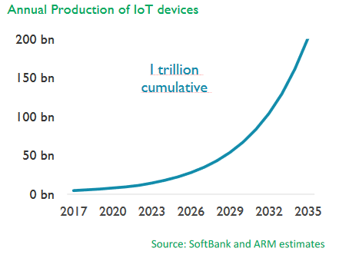
Battery is Not the Way to Go!
Batteries are bulky
Environmental-unfriendly
Cause significant maintenance cost
2
Notes:
As you know, most IoT devices rely on batteries. Thus, the increasing number of IoT devices indicates a high demand for batteries.
While batteries are a simple solution for IoT devices, they can be bulky, quick to drain depending on device functionality, and expensive to maintain and replace. In addition, replacing batteries causes a lot of dead batteries which leads to a huge environmental impact.
Energy harvesting systems emerged in response to these problems.

Slide 3

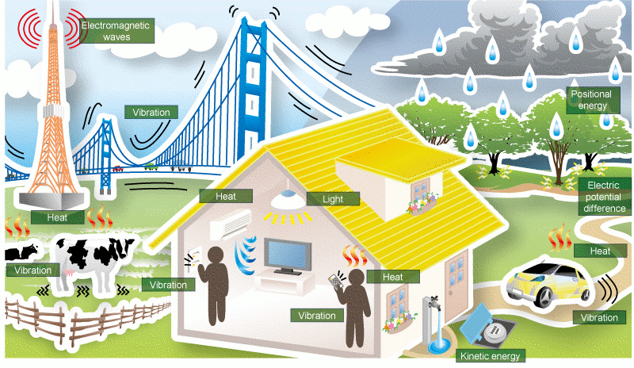
Energy Harvesting Systems (EHS)
WiFi
RF
Solar
Notes:
They can collect energy from various sources without battery, such as WIFI, radio frequency, and solar. However, those energy sources are not stable!

Slide 4
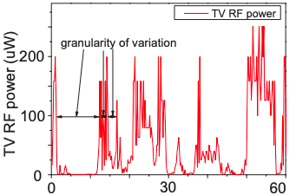
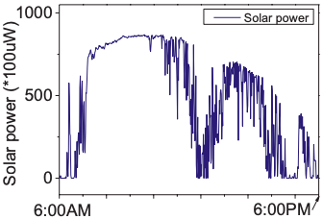
Unreliability of Ambient Energy Sources
Frequent power outages
(a). Time (s) (Sample time: 0.33us)
(b). Time (s) (Sample time: 0.33us)
[Ma,HPCA’2015]
Notes:
However, these energy sources are very unstable. These two figures show the real RF and solar power traces which are inconsistent, leading to frequent power outages.

Slide 5



Problem of Frequently Power Outages
Stagnation
∞
Timeline of program execution
: Power failure on which all volatile data is lost
56th IEEE/ACM International Symposium on Microarchitecture
Notes:
The problem is that [click]
During the program execution,
[click]
If a power failure happens in the middle of program execution, [click] all the program status is gone. The only way the program can recover is to restart from the program beginning.
[click]
If the power failure happens again and again before reaching the end of program [click], program never finishes, causing a so-called stagnation problem. [click]

Slide 6





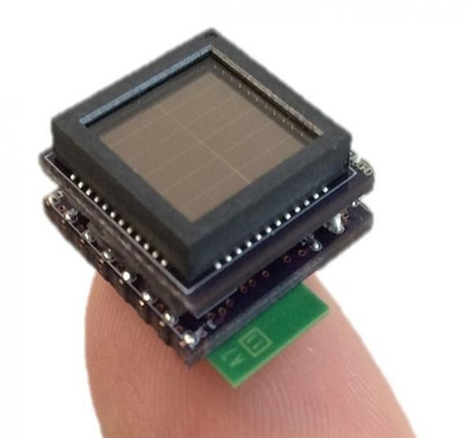
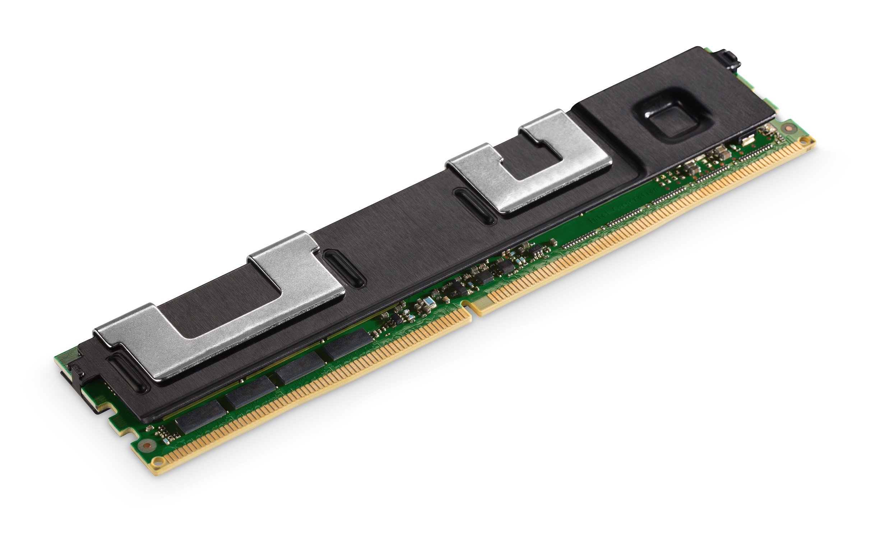
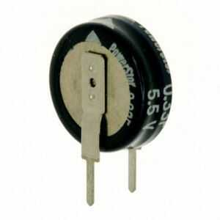
Overcoming Power Failure
Collect energy
(device off)
Run program
(device on)
Ambient energy
Intermittently compute only when enough energy is secured in a capacitor
Capacitor
(as energy buffer)
Non-Volatile
Memory (NVM)
Energy harvesting system
Notes:
To run a program in the presence of so many power failures.
EHSs leverage a capacitor as their energy buffer and utilize NVM as the main memory to protect their data against power outages.
While energy is harvested, it is piled in the capacitor. Once it is fully charged, the microprocessor starts to run the program by consuming the energy in the capacitor. When energy is fully depleted, it hyphenates the capacitor to charge again. And this cycle repeats forever.
In particular, program execution is often described as intermittent computation due to the discrete execution caused by frequent power failure.
However, the NVM itself cannot provide crash consistency because volatile registers are gone at moment of a power outage. With that in mind, people come up with (full name)NVP, leveraging JIT checkpointing to save registers just before a power outage. Let’s take a look at how it works.

Slide 7

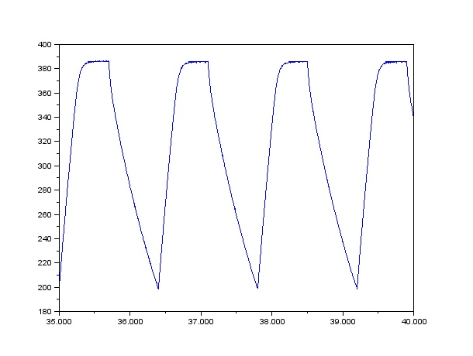
NVP: Just-in-time Register Checkpointing
Vdd
NVP
Register access is not delayed because of no NVFF access during program execution
Roll-forward recovery: program is resumed from the interruption point
Harvested
energy
Capacitor charge
Vbk
Voltage monitor
Vdd
Backup/recovery controller
Voff
Pipeline
NVM
Volatile register
NVFF
Time
[Ma,HPCA’2015]
Notes:
However, the NVM itself cannot provide crash consistency because volatile registers are gone at moment of power outage. With that in mind, people come up with NVP (full name), leveraging JIT checkpointing to save registers just before a power outage.
[click] To realize this, it uses a voltage monitor to checkpoint and restore RF.
[click, click]
When input voltage drops below backup threshold, [click] it stops the pipeline, voltage monitor signals backup controller to [click] checkpoint entire RF to (nonvolatile flip-flop) NVFF which is slower than RF because of non-volatile technology used.
[click]
At the time of power off, [click] volatile register content are lost.
[click] Once power comes back, [click] NVP reversely restores [click] register content from NVFF to the register file as we can see from the figure.
[click]
The beauty of NVP is, first, it never delays the register access since NVFF is never used during the program execution.
Second, in the wake of power failure, NVP can always resume the program where it is exactly interrupted.

Slide 8
NVP Has No Cache Due to Its Crash Consistency Issue
* We can’t restart program from the exactly failure point as NVP does
Pipeline
Cache
NVM
Volatile
Registers
NVFF
Notes:
[click] NVP usually doesn‘t have a cache even though NVM access latency is so long. The reason is volatile cache puts more pressure on crash consistency guarantee.
For example, [click] when the power is to be cut off, all RF content are checkpointed to NVFF. But cache content are lost.

Slide 9
NVSRAM: Incorporate NVP with an SRAM Cache
[Chui, VLSI’2010]
Vbk’
Voltage Monitor
Can we achieve a JIT-checkpoint-free design?
Secured higher voltage
Capacitor Charge
NVSRAM
Core
Backup/recovery Controller
Vbk
SRAM
Cache
Voff
NVM
NVM
backup
Volatile register
NVFF
Time
Notes:
To deal with this issue, in addition to checkpoint registers, NVSRAM also backups the SRAM Cache right before an impending power failure.
[click] When the power is of, all volatile data is gone.
[click]In the wake of power failure, [click] it reversely restores registers as well a SRAM Cache.
[click] Compared with NVP, NVSRAM has more work to do since it must checkpoint the entire cache apart from registers. That’s why NVSRAM must increase backup voltage to secure more energy which would otherwise can be used for making further program progress. Except that, it takes more time to secure high energy, leading to slow booting.
What’s more, JIT checkpointing causes significant hardware complexity, such as ….
So the question is ?

Slide 10


SweepCache: Enabling a Cache for EHS without JIT checkpointing
Voltage Monitor
Core
Backup/recovery Controller
SRAM
Cache
NVM
NVM
backup
Volatile register
NVFF
10
Notes:
The answer is yes. SweepCache is such a lightweight design enabling caches for EHS without JIT checkpointing.

Slide 11

Challenges for JIT-Checkpoint-Free Design
Q1: How to recover from power failure?
Q2: How to keep registers from power loss?
Q3: How to deal with cache states upon power outages?
Notes:
Now, without JIT checkpoint, we need to consider 3 questions here.
First, how can we recover from power failures; Second, how to make the registers survive from power loss; third, how to deal with the cache upon power outages?
For the first question, The lack of JIT checkpointing facility indicates we cannot do roll forward recovery. The only option left is roll back recovery.

Slide 12
Recovery without JIT Checkpointing
r1 = …
Q1: How to recover from power failure?
Region1
ckpt r1
Live-out
r2 = …
r3 (dead) = …
Q2: How to keep registers from power loss?
SweepCache
Compiler
ckpt r2
Region2
Live-out
… = r1
… = r2
r3 = …
Region3
: Region boundary
Notes:
To realize this, SweepCache’s compiler partitions the program into a serious of recoverable regions. During the region execution, if a power failure happens, it roll back to the previous region boundary.
In addition, without JIT checkpoiting, SweepCache compiler checkpoints live-out registers in each region so that they can be restored across power outages.

Slide 13


Challenges for Rollback Recovery
Write-after-read (WAR) dependence can cause incorrect recovery
Initial Mem[m1] = 0
Memory inconsistency!!
[m1] is supposed be 1
But due to WAR, it becomes 2
Cache
r1 = Load [m1]
r1 = r1+1
Store r1, [m1]
…
r2 = Load [m2]
…
Program control
[m1] =1
WAR
[m1] = 1
NVM
Cache miss!
[m2]
Who moves my cake?
Notes:
As with all other the rollback recovery, SweepCache must deal with WAR dependence to ensure crash consistency.
Here is the code that increases m1’s value from 0 to 1. We gonna use this example to show this simple semantic broken with WAR dependence.
When the program control reaches the store instruction,it updates the cacheline of address m1. After that, the following load encounters a miss and brings its cache block m2 with m1 evicted to NVM.
Before it gets to the region boundary, a power failure happens, all the data in the cache is gone. When power comes back, we roll back. [Pause] But here m1 has already changed to 1 in NVM, When we re-execute the load instruction, we read a wrong value, and m1 ends up being 2 which breaks the program semantic.
To solve this problem, SweepCache leverages a redo buffer which is resident in NVM to protect it against WAR by preventing in-place NVM updates.

Slide 14
Leverage Redo Buffer to Remove WAR Effect
Initial: [m1] = 0
WAR never affects NVM
After reboot: [m1] = 1
No one moves my Cake ^^
r1 = Load [m1]
r1 = r1+1
Store r1, [m1]
…
r2 = Load [m2]
…
Redo
Buffer
Cache
Program control
[m1] = 1
WAR
NVM
Cache miss!
[m2]
[m1] = 0
Redo Buffer is resident in NVM
Notes:
Let’s see how it works.
Here we have the same code. And at this program point, m1 is updated into the cache.
But when the eviction happens because of the load miss, instead of writing m1back to NVM, we direct it to the Redo Buffer which is resident in the NVM.
When the power is off, the data in the cache disappears.
Once power comes back, we roll back and ignore the data in redo buffer. When we re-execute the load, it can read original data for m1 because WAR doesn’t corrupt NVM.

Slide 15


Redo Buffer Must Not Overflow
Initial: [m1] = 0, [m3] = 1
Redo Buffer
r1 = Load [m1]
r2 = Load [m3]
r1 = r1 + 1
Store r1, [m1]
…
r1 = r1 + 1
Store r1, [m2]
…
r2= r2 + 1
Store r2, [m3]
…
r3 = Load [m4]
…
WAR
[m1] = 1
Cache
[m3] = 2
[m2] = 2
WAR
NVM
[m4]
Program control
Cache miss!
Notes:
In spite of this, Redo buffer must not overflow otherwise it cannot protect the data. For instance, we have region with a lot of stores and 2 WAR. At this program point, the buffer is fully occupied by m1 and m2. m3 is updated in the cache. Still we have a load miss and m3 is eviceted. Since Redo gets full, m3 cannot be placed in redo buffer.

Slide 16

Buffer Size Aware Region Partitioning
Store r1, [m1]
…
Store r2, [m2]
…
Store r1, [m1]
…
Store r2, [m2]
…
Store r3, [m3]
..
Store r4, [m4]
…
Store r5, [m5]
…
Store r6, [m6]
…
N
Buffer empty
Buffer full
Buffer size N
Store r3, [m3]
..
Store r4, [m4]
…
SweepCache
Compiler
N
Buffer empty
Buffer full
Store r5, [m5]
…
Store r6, [m6]
…
N
Program
Notes:
Taking that problem into consideration, SweepCache conducts buffer size aware region partitioning;
When the number hit the buffer size, SweepCache inserts a region boundary;
Furthermore, we cannot hold the data in the redo buffer forever. And the boundary is the place that we need to commit redo buffer;

Slide 17

Challenges for JIT-Checkpoint-Free Design
Q1: How to recover from power failure?
Q2: How to keep registers from power loss?
Q3: How to deal with cache states upon power outages?
Notes:
Without JIT checkpoint, we need to consider 3 questions here. For the first question, The lack of JIT checkpointing facility indicates we cannot do roll forward recovery. The only option left is roll back recovery.

Slide 18

Sweep Cache at Each Region Boundary
Initial: [m1] = 0, [m2] = 1
r1 = Load [m1]
r1 = r1 + 1
Store r1, [m1]
…
r2 = Load [m2]
r2 = r2 + 1
Store r2, [m2]
…
Region1
Sweep Cache
Redo
Buffer
[m1] = 1
Cache
[m1] = 1
[m2] = 2
[m2] = 2
Program control
NVM
Program control
r2 = Load [m2]
…
Region2
56th IEEE/ACM International Symposium on Microarchitecture
18
Notes:
However, the existence of a cache makes redo commit challenging. Let’s take a look why.
For example, we have 2 regions here. At this stage in the program, m2 is updated into the cache while m1 has been written back to the redo buffer.
When it moves to the region boundary, if we blindly flush redo buffer without caring about dirty cachelines, a crash inconsistency arises.
For example, a power failure happens in the next region we lost the cache status.
Now, I want us to think together a little bit about what is the fundamental reason for crash inconsistency？[Pause]
What’s happening here is not all the stores of region1 have committed.
Let’s revisit the status as we get to the region boundary. To deal with this issue without complicating hardware design, we found out that we simply can sweep all the dirty cachlines into the redo buffer. After that, we flush the redo buffer. In this way, all the stores are guaranteed to commit.
Now we’ve covered the basic idea of SweepCache. Let’s see how SweepCache achieve correct recovery.

Slide 19

Failure Recovery (Case 1)
Region execution
commit
Timeline
Initial: [m1] = 0, [m2] = 1
Correct Recovery!
After reboot: [m1] = 0
r1 = Load [m1]
r1 = r1 + 1
Store r1, [m1]
…
r2 = Load [m2]
r2 = r2 + 1
Store r2, [m2]
…
Redo
Buffer
[m1] = 1
Cache
[m2] = 2
NVM
[m1 ]= 0
Program control
[m2 ]= 1
Notes:
In case a power failure occurs during the region execution, the data in the cache is lost. Once the power comes, we roll back and ignore the redo buffer content. Since NVM remains intact, we read the correct data for m1 when re-executing the load.

Slide 20

Failure Recovery (Case 2)
commit
Region execution
Timeline
Redo buffer helps to achieve safe recovery
r1 = Load [m1]
r1 = r1 + 1
Store r1, [m1]
…
r2 = Load [m2]
r2 = r2 + 1
Store r2, [m2]
…
Redo the commit
Redo
Buffer
[m1]
Cache
[m2]
NVM
Program control
commit
flush m1
flush m2
Notes:
Suppose now we already flush all the dirty cachelines into redo buffer and start to commit redo buffer.
But when we flush m2, a power failure happens. Since redo buffer is non-volatile, the data still remain in the buffer. In the wake of power outage, we can redo the commit.

Slide 21

Redo Commit Slows Down Program Execution
…
Store r1, [m1]
Store r2, [m2]
…
Region 1
sweep
Wait for flushing dirty cachelines
commit
Store r3, [m3]
…
Region 2
Redo commit may degrade the performance
sweep
commit
Notes:
Yet, the redo commit can slow down the program execution. Because the next region cannot start until the prior region commit all of its stores.
For example, the region 2 cannot start, until region 1 finish its commit process. And this can degrade the performance.

Slide 22

Region-Level Parallelism
…
Store r1, [m1]
Store r2, [m2]
…
`
…
Store r1, [m1]
Store r2, [m2]
…
Region1
Overlap
sweep
sweep
Store r3, [m3]
…
commit
commit
Overlap
Store r3, [m3]
…
sweep
Store r4, [m4]
…
Region 2
commit
sweep
commit
Speedup!
Store r4, [m4]
…
Region 3
Notes:
To address this issue, SweepCache proposes region-level parallelism to hide the commit latency by the execution of the next region.
For example, when region1 starts to sweep the dirty cachlines, region 2 initiates its execution which overlap the commit latency for region 1. And the same for region 2 and region 3. In this way, we can speedup the program execution because region level parallelism can hide the long commit delay.

Slide 23

Cache Miss Handling
Cache miss!
Traditional
data path
SweepCache
data path
Cache
Cache
Two times NVM accesses
Store r1, [m1]
…
Store r2, [m2]
…
[m1]
[m3]
First NVM access
Program control
[m4]
[m2]
SweepCache makes every region start with a clean cache
Single NVM access
Store r3, [m3]
..
Store r4, [m4]
…
Redo
Buffer
NVM
NVM
Redo buffer is empty most of the time
Store r5, [m5]
…
Store r6, [m6]
…
Second NVM access
Notes:
Unlike the traditional data path in the left, SweepCache has a Redo buffer sitting between the Cache and NVM in the data path. Thus, whenever a cache miss happens, it has to consult the buffer first. If it doesn’t find the data, it need to accesses NVM, causing two times NVM accesses, which can degrade performance.
However, the beauty of SweepCache is that it sweeps all the dirty cachelines making every region start with a clean cache. In this way, the cache can accommodate almost all the stores of the next region with barely any evictions, making the redo buffer empty most of the time during the region execution.

Slide 24
Bypass Redo Buffer By Empty-Bit
Cache miss!
Store r1, [m1]
…
Store r2, [m2]
…
Cache
m5
Program control
m3
Empty Bit?
bypassing the Redo buffer access (99% bypass rate)
Region 1
Store r3, [m3]
Store r4, [m4]
Load [m5]
Store r5, [m6]
Load [m7]
…
Empty Bit?
Not find [m7]
Redo
Buffer
1
0
Region 2
NVM
Store r6, [m7]
…
Store r7, [m8]
…
Region 3
Bypass
Redo buffer
Notes:
With that in mind, SweepCache proposes a simple but effective solution, called empty-bit to indicate whether the buffer is empty; if it is empty, we can bypass the buffer access.
For example, in the event of a cache miss in region 1, empty-bit is 1, indicating that the buffer is empty, allowing us to skip the buffer search entirely.
However, when a cache miss arises in region 2, where the buffer is not empty, it results in two NVM accesses.
But in 99% of cases, the buffer search can be bypassed.

Slide 25
Evaluation
Gem5 (NVPSim) + LLVM (compiler)
Mibench + Mediabench
Baseline: NVP (without SRAM cache)
Power traces: RFOffice and RFHome
Notes:
We use gem5 as our simulator and llvm as our compiler, and employ mibench and mediabench as our benchmarks. Our baseline is NVP while using the RF traces as our power traces.

Slide 26
Performance with Power Outages
3.49 x
speedup
6.35 x
speedup
3.47 x
speedup
6.04 x
speedup
[Bhattacharyya, ISCA’22]
[Zeng, MICRO’21]
RFHome
RFOffice
SweepCache shows the best performance;
Compared with ReplayCache and NvMR, SweepCache delivers significant speedups.
Notes:
All of these designs rely on JIT-checkpointing.
We already introduce NVSRAM before; NVMR is the state-art-of the work, which eliminated WAR by hardware memory renaming which is more like hardware-oriented approach; ReplayCache utilizes the compiler to generate a sequence of regions in which none of the store registers can be overwritten; so that it can replay the un-persisted stores across power failure, it’s more like software-oriented approach;

Slide 27
Energy Efficiency
Compared with NVP, the normalized total energy consumption for ReplayCache, NvMR, NVSRAM, and SweepCache are 20.86%, 57.86%, 12.37%, and 10.21%, respectively.
SweepCache turns out to be the most energy-efficient.

Slide 28
Conclusion
SweepCache
A novel compiler and architecture co-design enabling a volatile cache for EHS without expensive JIT checkpointing.
Achieve a large margin of speedups over the state-of-art work.
Thank You
Q&A

